Slide 1
AUTOMATA
&
COMPUTABILITY
CSE 331, CSE BRAC

Slide 2
Language of a PDA
The common way to define the language of a PDA is by final state.
If P is a PDA, then L(P) is the set of strings w such that (q₀, w, Z₀) ⊦* (f, ε, α) for final state f and any α.

Slide 3
Language of a PDA – (2)
Another language defined by the same PDA is by empty stack.
If P is a PDA, then N(P) is the set of strings w such that (q₀, w, Z₀) ⊦* (q, ε, ε) for any state q.

Slide 4
δ : The Transition Function
old state
input symb.
Stack top
new state(s)
new Stack top(s)
δ : Q x ∑ x Γ => Q x Γ
δ(q,a,X) = {(p,Y), …}
  state transition from q to p
  a is the next input symbol
  X is the current stack top symbol
  Y is the replacement for X;
  it is in Γ* (a string of stack symbols)
    Set Y = ε for: Pop(X)
    If Y=X: stack top is unchanged
    If Y=Z₁Z₂…Z_{k}: X is popped and is replaced by Y
    in reverse order (i.e., Z₁ will be the
    new stack top)
a
X
Y
q
p
Non-determinism
 | Y = ? | Action
i) | Y=ε | Pop(X)
ii) | Y=X | Pop(X) Push(X)
iii) | Y=Z₁Z₂..Z_{k} | Pop(X) Push(Z_{k}) Push(Z_{k-1}) … Push(Z₂) Push(Z₁)
Notes:
Cpt S 317: Spring 2009
School of EECS, WSU

Slide 5
Example
Let L_{wwr} = {ww^{R} | w is in (0+1)*}
CFG for L_{wwr} : S==> 0S0 | 1S1 | ε
PDA for L_{wwr} :
P := ( Q,∑, Γ, δ,q₀,Z₀,F )
= ( {q₀, q₁, q₂},{0,1},{0,1,Z₀},δ,q₀,Z₀,{q₂})
Notes:
Cpt S 317: Spring 2009
School of EECS, WSU

Slide 6
PDA for L_{wwr}
Initial state of the PDA:
q₀
Stack
top
Z₀
δ(q₀,0, Z₀)={(q₀,0Z₀)}
δ(q₀,1, Z₀)={(q₀,1Z₀)}
δ(q₀,0, 0)={(q₀,00)}
δ(q₀,0, 1)={(q₀,01)}
δ(q₀,1, 0)={(q₀,10)}
δ(q₀,1, 1)={(q₀,11)}
δ(q₀, ε, 0)={(q₁, 0)}
δ(q₀, ε, 1)={(q₁, 1)}
δ(q₀, ε, Z₀)={(q₁, Z₀)}
δ(q₁,0, 0)={(q₁, ε)}
δ(q₁,1, 1)={(q₁, ε)}
δ(q₁, ε, Z₀)={(q₂, Z₀)}
First symbol push on stack
Grow the stack by pushing
new symbols on top of old
(w-part)
Switch to popping mode
(boundary between w and w^{R})
Shrink the stack by popping matching
symbols (w^{R}-part)
Enter acceptance state
Notes:
Cpt S 317: Spring 2009
School of EECS, WSU

Slide 7
PDA as a state diagram
δ(q_{i},a, X)={(q_{j},Y)}
Current
state
Next
input
symbol
Current
stack
top
Stack
Top
Replacement
(w/ string Y)
Current
state
a, X / Y
Next
state
q_{i}
q_{j}
Notes:
Cpt S 317: Spring 2009
School of EECS, WSU

Slide 8
PDA for L_{wwr}: Transition Diagram
Grow stack
∑ = {0, 1}
= {Z₀, 0, 1}
Q = {q₀,q₁,q₂}
0, Z₀/0Z₀
1, Z₀/1Z₀
0, 0/00
0, 1/01
1, 0/10
1, 1/11
Pop stack for
matching symbols
0, 0/ ε
1, 1/ ε
ε, Z₀/Z₀
q₀
q₁
q₂
ε, Z₀/Z₀
ε, 0/0
ε, 1/1
ε, Z₀/Z₀
Go to acceptance
Switch to
popping mode
This would be a non-deterministic PDA
Notes:
Cpt S 317: Spring 2009
School of EECS, WSU

Slide 9
Example 2: language of balanced paranthesis
Pop stack for
matching symbols
∑ = { (, ) }
= {Z₀, ( }
Q = {q₀,q₁,q₂}
Grow stack
(, Z₀ / ( Z₀
(, ( / ( (
), ( / ε
ε, Z₀ / Z₀
q₀
q₁
q₂
), ( / ε
ε, Z₀ / Z₀
ε, Z₀ / Z₀
Go to acceptance (by final state)
when you see the stack bottom symbol
Switch to
popping mode
(, ( / ( (
(, Z₀ / ( Z₀
To allow adjacent
blocks of nested paranthesis
Notes:
Cpt S 317: Spring 2009
School of EECS, WSU

Slide 10
Example 2: language of balanced paranthesis (another design)
∑ = { (, ) }
= {Z₀, ( }
Q = {q₀,q₁}
(,Z₀ / ( Z₀
(,( / ( (
), ( / ε
start
ε,Z₀/ Z₀
q₀
q₁
ε,Z₀/ Z₀
Notes:
Cpt S 317: Spring 2009
School of EECS, WSU

Slide 11
How does the PDA for L_{wwr} work on input “1111” (using IDs)?
All moves made by the non-deterministic PDA
(q₀,1111,Z₀)
(q₀,111,1Z₀)
(q₁,1111,Z₀)
Path dies…
(q₀,11,11Z₀)
(q₁,111,1Z₀)
Path dies…
(q₀,1,111Z₀)
(q₁,11,11Z₀)
(q₀,ε,1111Z₀)
(q₁,1,111Z₀)
(q₁,1,1Z₀)
Acceptance by
final state:
= empty input
AND
final state
(q₁, ε,1111Z₀)
(q₁, ε,11Z₀)
(q₁, ε,Z₀)
Path dies…
Path dies…
(q₂, ε,Z₀)
Notes:
Cpt S 317: Spring 2009
School of EECS, WSU

Slide 12
Acceptance by…
There are two types of PDAs that one can design:
those that accept by final state or by empty stack
PDAs that accept by final state:
  For a PDA P, the language accepted by P, denoted by L(P) by final state, is:
    {w | (q₀,w,Z₀) |---* (q,ε, A) }, s.t., q ∈ F
PDAs that accept by empty stack:
  For a PDA P, the language accepted by P, denoted by N(P) by empty stack, is:
    {w | (q₀,w,Z₀) |---* (q, ε, ε) }, for any q ∈ Q.
Checklist:
- input exhausted?
- in a final state?
Q) Does a PDA that accepts by empty stack
need any final state specified in the design?
Checklist:
- input exhausted?
- is the stack empty?
Notes:
Cpt S 317: Spring 2009
School of EECS, WSU

Slide 13
Example: L of balanced parenthesis
An equivalent PDA that
accepts by empty stack
PDA that accepts by final state
(,Z₀ / ( Z₀
(, ( / ( (
), ( / ε
ε,Z₀ / ε
P_{F}:
P_{N}:
(,Z₀ / ( Z₀
(,( / ( (
), ( / ε
start
ε,Z₀/ Z₀
start
q₀
q₁
q₀
ε,Z₀/ Z₀
ε,Z₀/ Z₀
How will these two PDAs work on the input: ( ( ( ) ) ( ) ) ( )

Slide 14
PDAs accepting by final state and empty stack are equivalent
P_{F} <= PDA accepting by final state
  P_{F} = (Q_{F},∑, Γ, δ_{F},q₀,Z₀,F)
P_{N} <= PDA accepting by empty stack
  P_{N} = (Q_{N},∑, Γ, δ_{N},q₀,Z₀)
Theorem:
  (P_{N}==> P_{F}) For every P_{N}, there exists a P_{F} s.t. L(P_{F})=L(P_{N})
  (P_{F}==> P_{N}) For every P_{F}, there exists a P_{N} s.t. L(P_{F})=L(P_{N})
Notes:
Cpt S 317: Spring 2009
School of EECS, WSU

Slide 15
P_{N}==> P_{F} construction
How to convert an empty stack PDA into a final state PDA?
Whenever P_{N}’s stack becomes empty, make P_{F} go to a final state without consuming any addition symbol
To detect empty stack in P_{N}: P_{F} pushes a new stack symbol X₀ (not in Γ of P_{N}) initially before simultating P_{N}
P_{F}:
P_{N}:
ε, X₀/ X₀
ε, X₀/Z₀X₀
ε, X₀/ X₀
New
start
ε, X₀/ X₀
p₀
q₀
…
p_{f}
ε, X₀ / X₀
ε, X₀/ X₀
P_{N}
  P_{F} = (Q_{N} U {p₀,p_{f}}, ∑, Γ U {X₀}, δ_{F}, p₀, X₀, {p_{f}})
Notes:
Cpt S 317: Spring 2009
School of EECS, WSU

Slide 16
Example: Matching parenthesis “(” “)”
P_{N}: ( {q₀}, {(,)}, {Z₀,Z₁}, δ_{N}, q₀, Z₀ )
δ_{N}: δ_{N}(q₀,(,Z₀) = { (q₀,Z₁Z₀) }
δ_{N}(q₀,(,Z₁) = { (q₀, Z₁Z₁) }
δ_{N}(q₀,),Z₁) = { (q₀, ε) }
δ_{N}(q₀, ε,Z₀) = { (q₀, ε) }
P_{f}: ( {p₀,q₀ ,p_{f}}, {(,)}, {X₀,Z₀,Z₁}, δ_{f}, p₀, X_{0 ,} p_{f})
δ_{f}: δ_{f}(p₀, ε,X₀) = { (q₀,Z₀) }
δ_{f}(q₀,(,Z₀) = { (q₀,Z₁ Z₀) }
δ_{f}(q₀,(,Z₁) = { (q₀, Z₁Z₁) }
δ_{f}(q₀,),Z₁) = { (q₀, ε) }
δ_{f}(q₀, ε,Z₀) = { (q₀, ε) }
δ_{f}(p₀, ε,X₀) = { (p_{f}, X₀ ) }
(,Z₀ /Z₁Z₀
(,Z₁ /Z₁Z₁
),Z₁ / ε
ε,Z₀ / ε
(,Z₀/Z₁Z₀
(,Z₁/Z₁Z₁
),Z₁/ ε
ε ,Z₀/ ε
start
start
ε,X₀/Z₀X₀
ε,X₀/ X₀
q₀
p₀
q₀
p_{f}
Accept by empty stack
Accept by final state
Notes:
Cpt S 317: Spring 2009
School of EECS, WSU

Slide 17
P_{F}==> P_{N} construction
How to convert an final state PDA into an empty stack PDA?
Main idea:
  Whenever P_{F} reaches a final state, just make an ε -transition into a new end state, clear out the stack and accept
  Danger: What if P_{F} design is such that it clears the stack midway without entering a final state?
  ➔ to address this, add a new start symbol X₀ (not in Γ of P_{F})
  P_{N} = (Q U {p₀,p_{e}}, ∑, Γ U {X₀}, δ_{N}, p₀, X₀)
P_{N}:
ε, X₀/Z₀X₀
ε, any/ ε
ε, any/ ε
New
start
ε, any/ ε
p₀
q₀
…
p_{e}
ε, any/ ε
P_{F}
Notes:
Cpt S 317: Spring 2009
School of EECS, WSU

Slide 18
Equivalence of PDAs and CFGs
Notes:
Cpt S 317: Spring 2009
School of EECS, WSU

Slide 19
CFGs == PDAs ==> CFLs
PDA by
final state
PDA by
empty stack
≡
?
CFG
Notes:
Cpt S 317: Spring 2009
School of EECS, WSU

Slide 20
Converting a CFG into a PDA
This is same as: “implementing a CFG using a PDA”
Main idea: The PDA simulates the leftmost derivation on a given w, and upon consuming it fully it either arrives at acceptance (by empty stack) or non-acceptance.
Steps:
  Push the right hand side of the production onto the stack, with leftmost symbol at the stack top
  If stack top is the leftmost variable, then replace it by all its productions (each possible substitution will represent a distinct path taken by the non-deterministic PDA)
  If stack top has a terminal symbol, and if it matches with the next symbol in the input string, then pop it
State is inconsequential (only one state is needed)
Notes:
Cpt S 317: Spring 2009
School of EECS, WSU

Slide 21
Formal construction of PDA from CFG
Note: Initial stack symbol (S)
same as the start variable
in the grammar
Given: G= (V,T,P,S)
Output: P_{N} = ({q}, T, V U T, δ, q, S)
δ:
  For all A ∈ V , add the following transition(s) in the PDA:
    δ(q, ε ,A) = { (q, α) | “A ==>α” ∈ P}
  For all a ∈ T, add the following
  transition(s) in the PDA:
    δ(q,a,a)= { (q, ε ) }
Before:
After:
A
α
…
…
Before:
After:
a…
a
a
pop
…
…
Notes:
Cpt S 317: Spring 2009
School of EECS, WSU

Slide 22
Example: CFG to PDA
1,1 / ε
0,0 / ε
ε,A / 01
ε,A / A1
ε,A / 0A1
ε,S / ε
ε,S / AS
G = ( {S,A}, {0,1}, P, S)
P:
  S ==> AS | ε
  A ==> 0A1 | A1 | 01
PDA = ({q}, {0,1}, {0,1,A,S}, δ, q, S)
δ:
  δ(q, ε , S) = { (q, AS), (q, ε )}
  δ(q, ε , A) = { (q,0A1), (q,A1), (q,01) }
  δ(q, 0, 0) = { (q, ε ) }
  δ(q, 1, 1) = { (q, ε ) }
ε,S / S
q
How will this new PDA work?
Lets simulate string 0011
Notes:
Cpt S 317: Spring 2009
School of EECS, WSU

Slide 23
Simulating string 0011 on the new PDA …
Leftmost deriv.:
1,1 / ε
0,0 / ε
ε,A / 01
ε,A / A1
ε,A / 0A1
ε,S / ε
ε,S / AS
S => AS
=> 0A1S
=> 0011S
=> 0011
PDA (δ):
  δ(q, ε , S) = { (q, AS), (q, ε )}
  δ(q, ε , A) = { (q,0A1), (q,A1), (q,01) }
  δ(q, 0, 0) = { (q, ε ) }
  δ(q, 1, 1) = { (q, ε ) }
ε,S / S
Stack moves (shows only the successful path):
q
0
0
A
A
1
1
A
1
1
1
1
1
Accept by
empty stack
S
S
S
S
S
S
S
S
0
0
1
1
ε
S =>AS =>0A1S =>0011S => 0011

Slide 24
Converting a PDA into a CFG
Main idea: Reverse engineer the productions from transitions
If δ(q,a,Z) => (p, Y₁Y₂Y₃…Y_{k}):
      State is changed from q to p;
      Terminal a is consumed;
      Stack top symbol Z is popped and replaced with a sequence of k variables.
  Action: Create a grammar variable called “[qZp]” which includes the following production:
      [qZq_{k}] => a[pY₁q₁] [q₁Y₂q₂] [q₂Y₃q₃]… [q_{k-1}Y_{k}q_{k}]
  Proof discussion (in the book)
Notes:
Cpt S 317: Spring 2009
School of EECS, WSU

Slide 25
Example: Bracket matching
To avoid confusion, we will use b=“(“ and e=“)”
P_{N}: ( {q₀}, {b,e}, {Z₀,Z₁}, δ, q₀, Z₀ )
δ(q₀,b,Z₀) = { (q₀,Z₁Z₀) }
δ(q₀,b,Z₁) = { (q₀,Z₁Z₁) }
δ(q₀,e,Z₁) = { (q₀, ε ) }
δ(q₀, ε ,Z₀) = { (q₀, ε ) }
0. S => [q₀Z₀q₀]
[q₀Z₀q₀] => b [q₀Z₁q₀] [q₀Z₀q₀]
[q₀Z₁q₀] => b [q₀Z₁q₀] [q₀Z₁q₀]
[q₀Z₁q₀] => e
[q₀Z₀q₀] => ε
Let A=[q₀Z₀q₀]
Let B=[q₀Z₁q₀]
0. S => A
A => b B A
B => b B B
B => e
A => ε
Simplifying,
0. S => b B S | ε
B => b B B | e
If you were to directly write a CFG:
S => b S e S | ε
Notes:
Cpt S 317: Spring 2009
School of EECS, WSU

Slide 26
Two ways to build a CFG
Build a PDA
Construct
CFG from PDA
(indirect)
Derive CFG directly
(direct)
Similarly…
Two ways to build a PDA
Derive a CFG
Construct
PDA from CFG
(indirect)
Design a PDA directly
(direct)
Notes:
Cpt S 317: Spring 2009
School of EECS, WSU

Slide 27
Deterministic PDAs
Notes:
Cpt S 317: Spring 2009
School of EECS, WSU

Slide 28
This PDA for L_{wwr} is non-deterministic
Grow stack
Why does it have to be non-deterministic?
0, Z₀/0Z₀
1, Z₀/1Z₀
0, 0/00
0, 1/01
1, 0/10
1, 1/11
Pop stack for
matching symbols
0, 0/ ε
1, 1/ ε
q₀
q₁
q₂
ε, Z₀/Z₀
ε, 0/0
ε, 1/1
ε, Z₀/Z₀
Accepts by final state
Switch to
popping mode
To remove guessing, impose the user to insert c in the middle
Notes:
Cpt S 317: Spring 2009
School of EECS, WSU

Slide 29
Deterministic PDA: Definition
A PDA is deterministic if and only if:
  δ(q,a,X) has at most one member q in Q for any a ∈ ∑ U {ε} and any stack symbol X.
  If δ(q,a,X) is non-empty for some a∈∑, then δ(q, ε,X) must be empty.
Notes:
Cpt S 317: Spring 2009
School of EECS, WSU

Slide 30
D-PDA for L_{wcwr} = {wcw^{R} | c is some special symbol not in w}
Example shows that: Nondeterministic PDAs ≠ D-PDAs
Note:
all transitions have become deterministic
Grow stack
Pop stack for
matching symbols
0, Z₀/0Z₀
1, Z₀/1Z₀
0, 0/00
0, 1/01
1, 0/10
1, 1/11
0, 0/ ε
1, 1/ ε
q₀
q₁
q₂
c, Z₀/Z₀
c, 0/0
c, 1/1
ε, Z₀/Z₀
Accepts by
final state
Switch to
popping mode
Notes:
Cpt S 317: Spring 2009
School of EECS, WSU

Slide 31
PDA vs DPDA vs Regular languages
L_{wcwr}
L_{wwr}
non-deterministic PDA
D-PDA
Regular languages
Notes:
Cpt S 317: Spring 2009
School of EECS, WSU

Slide 32
Summary
PDAs for CFLs and CFGs
  Non-deterministic
  Deterministic
PDA acceptance types
  By final state
  By empty stack
PDA
  IDs, Transition diagram
Equivalence of CFG and PDA
  CFG => PDA construction
  PDA => CFG construction
Notes:
Cpt S 317: Spring 2009
School of EECS, WSU

Slide 33

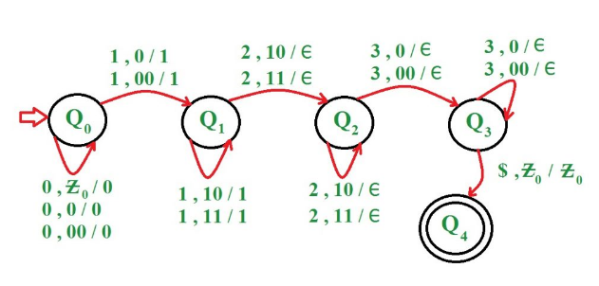
PDA examples

Slide 34
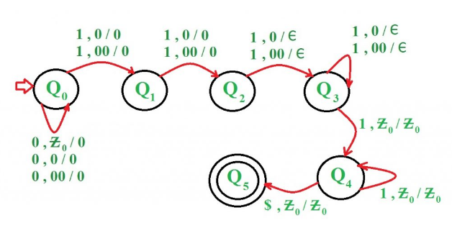
PDA Examples (..contd)

Slide 35
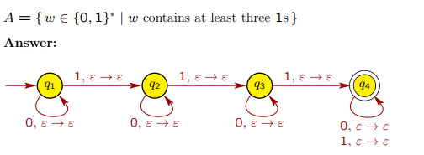
PDA Examples (..contd)

Slide 36

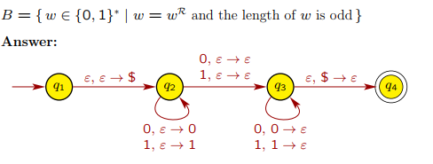
PDA Examples (..contd)

Slide 37
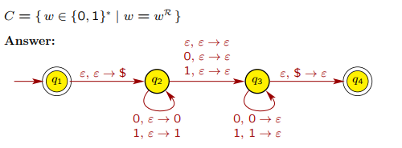
PDA Examples (..contd)

Slide 38
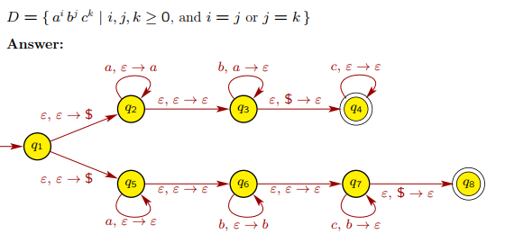
PDA Examples (..contd)

Slide 39
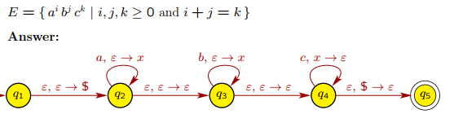
PDA Examples (..contd)

Slide 40
Thank You

